Slide 1
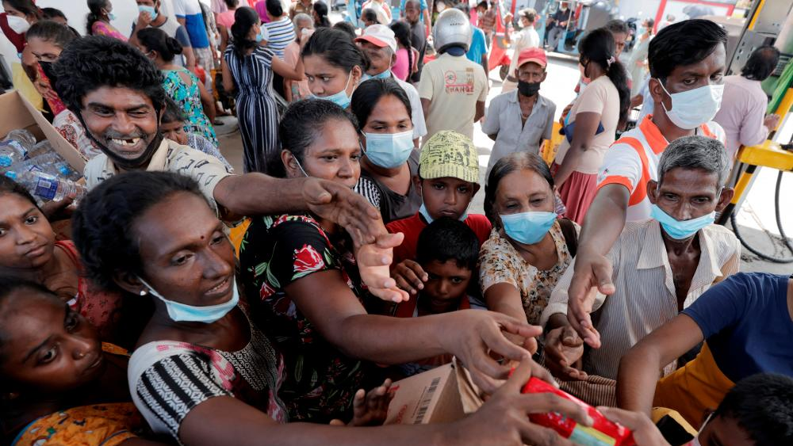
SRILANKA’S ECONOMIC CRISIS
Source : jkpi.org

Slide 2
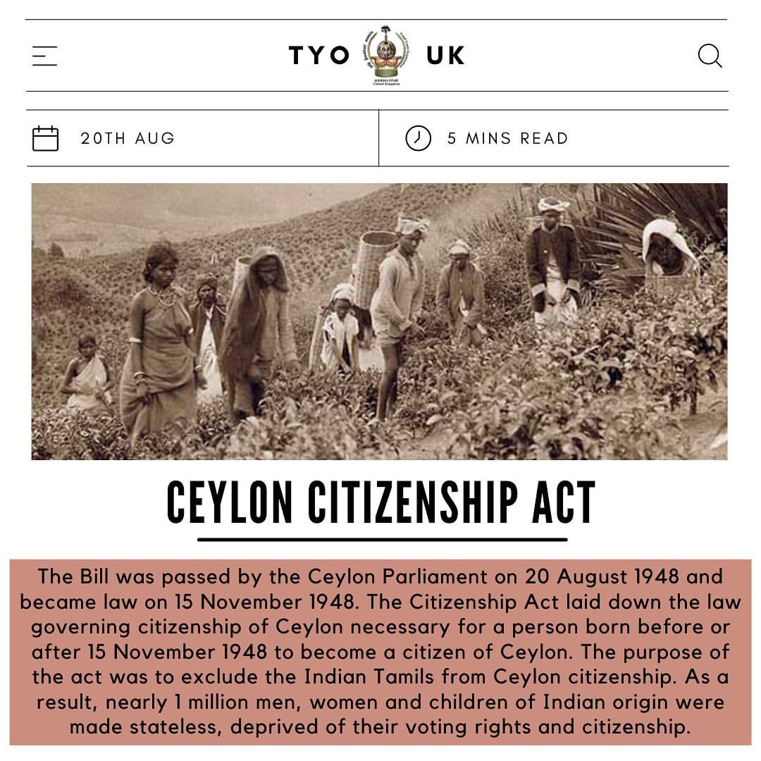
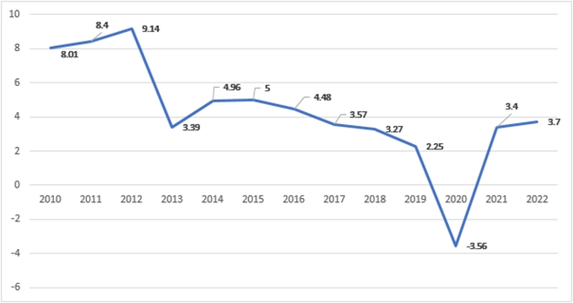
HISTORY
Sri Lanka’s GDP growth rate (2010-2020)
Source: tyouk.tumblr.com
Source: World Bank,2022 Projection by central bank of srilanka

Slide 3
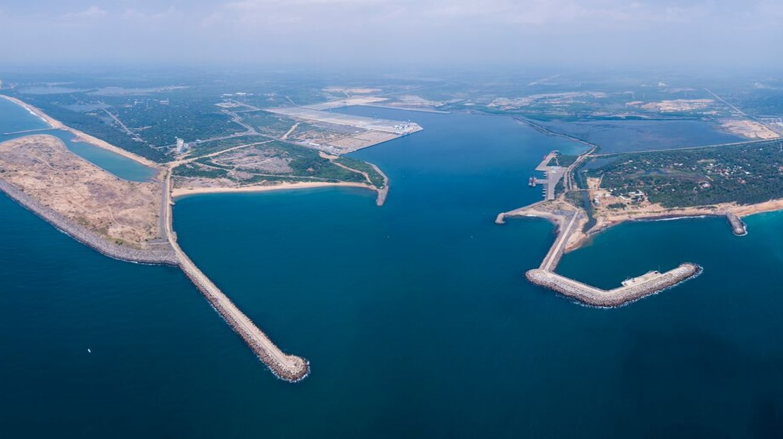
STRENGTHS
Islandic nation with a vast coastline
Diversified agricultural production (tea, coconuts, rubber)
high literacy rate
Strong cultural heritage and attractions for tourism
Source: srilankafoundation.org

Slide 4
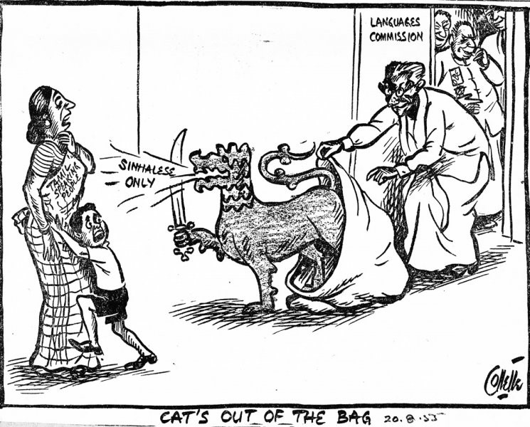

WEAKNESS
High debt burden and debt servicing costs
Ethnic tensions
short-term external financing
Dependence on imports
Political instability and corruption
Source: sites.udel.edu

Slide 5
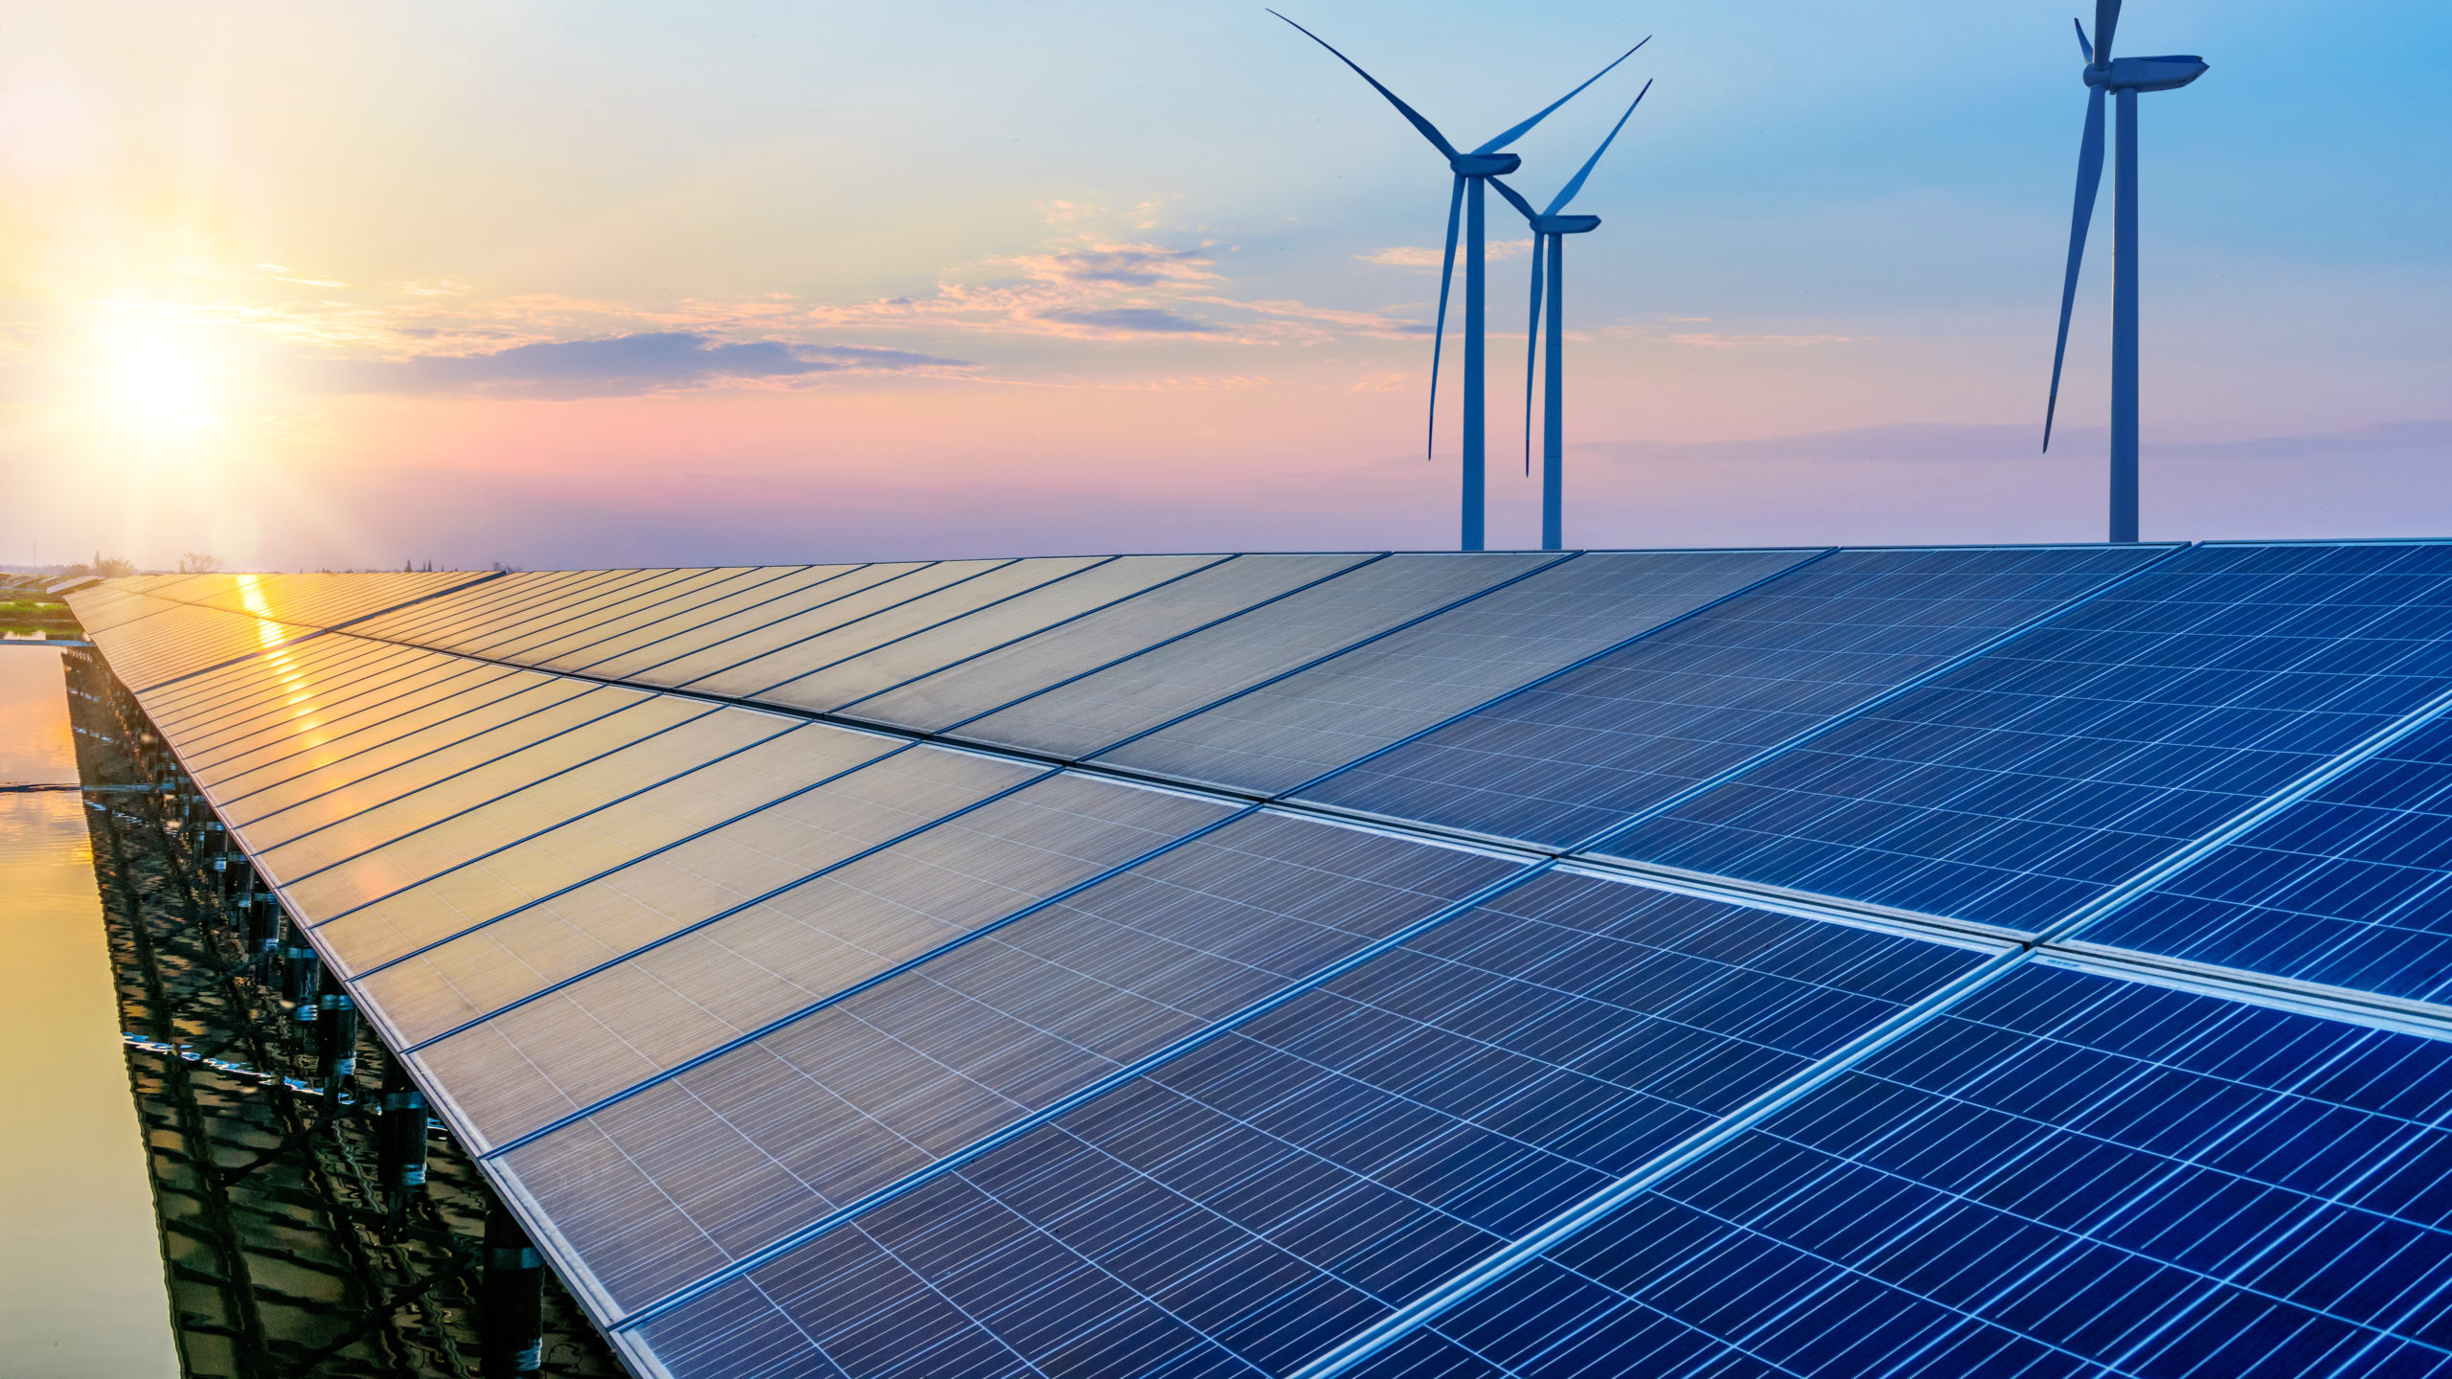
OPPORTUNITIES
Diversification of the economy into new industries such as renewable energy
Investment in infrastructure development
Development of regional trade
Source: renewableenergyworld

Slide 6
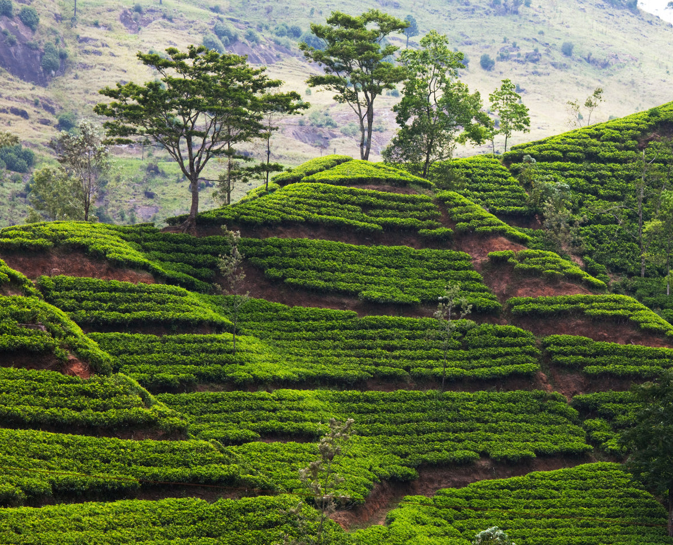
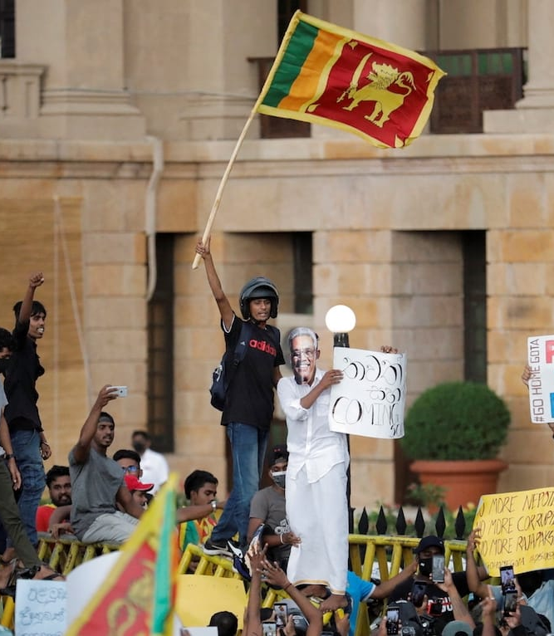
THREATS
Global economic uncertainties
Impact of COVID-19
Political instability
Dependence on a few key export products
Climate change and natural disasters
Source: crisisgroup.org

Slide 7
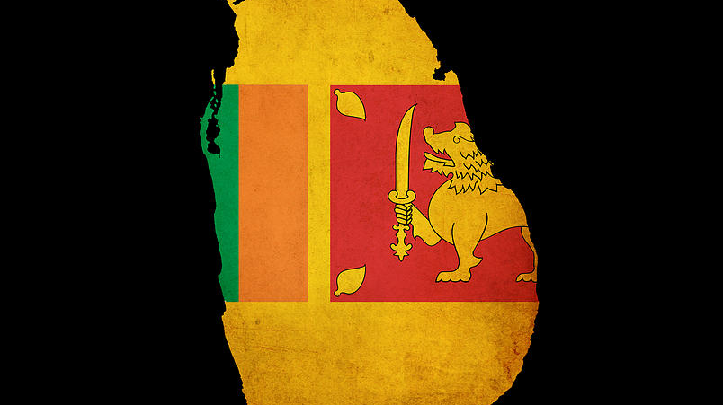
Thank you

